Slide 1
AI E-Commerce
AI-Powered Intelligent Shopping Assistance
Presented by:
Name : N. Sowmya
Roll No: 23NN1A4241
Branch : CSE-AIML

Slide 2
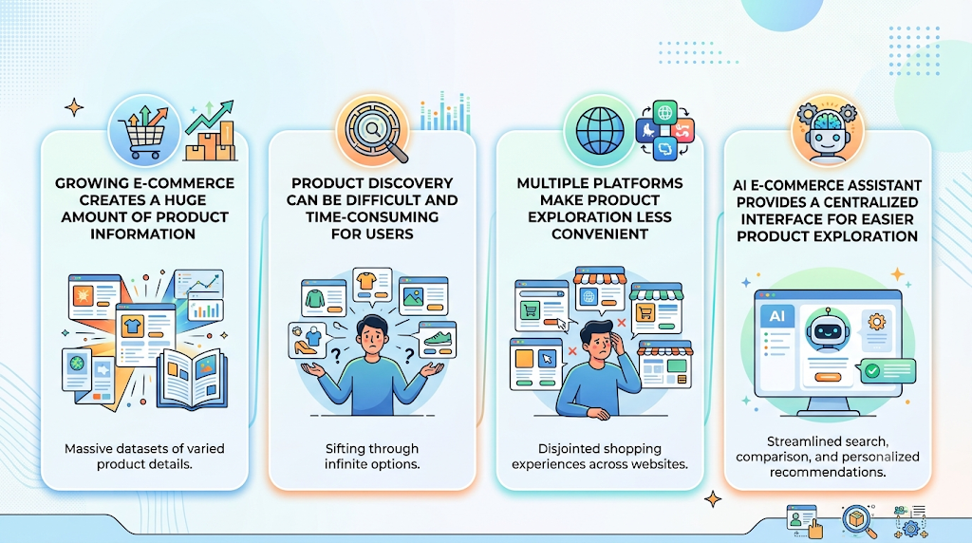
INTRODUCTION
🛒 Growing e-commerce creates a huge amount of product information.
🔍 Product discovery can be difficult and time-consuming for users.
🌐 Multiple platforms make product exploration less convenient.
🤖 AI E-Commerce Assistant provides a centralized interface for easier product exploration.

Slide 3
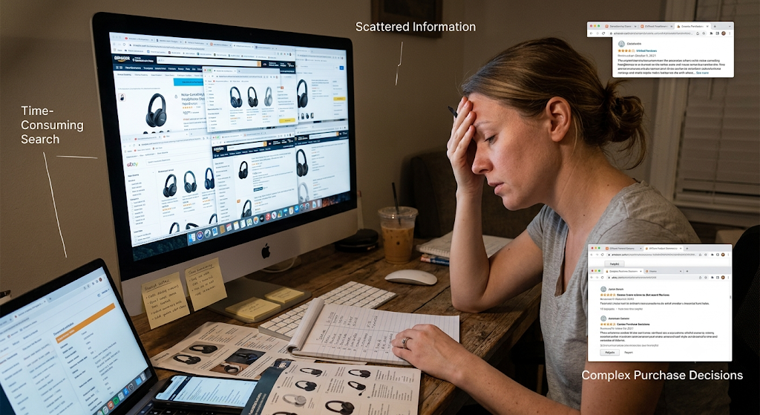
PROBLEM STATEMENT
🔎 Difficult Product Discovery — Finding suitable products among many options is challenging.
🌐 Scattered Information — Product information is spread across different e-commerce platforms.
⏱️ Time-Consuming Search — Exploring and comparing multiple products requires more time.
🤔 Complex Purchase Decisions — Users may find it difficult to identify suitable products from

Slide 4
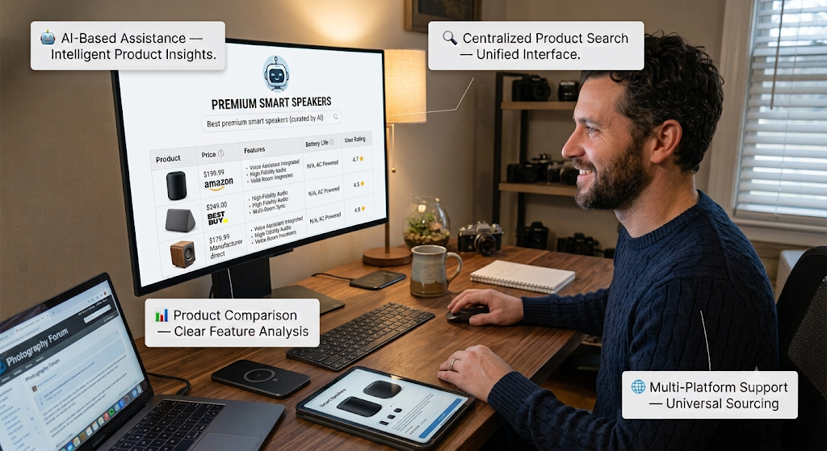
PROPOSED SOLUTION
AI-Based Assistance — Provides intelligent support for product exploration.
🔍 Centralized Product Search — Helps users explore product information through one interface.
📊 Product Comparison — Makes it easier to examine different product options.
🌐 Multi-Platform Support — Covers products from major e-commer platforms.

Slide 5
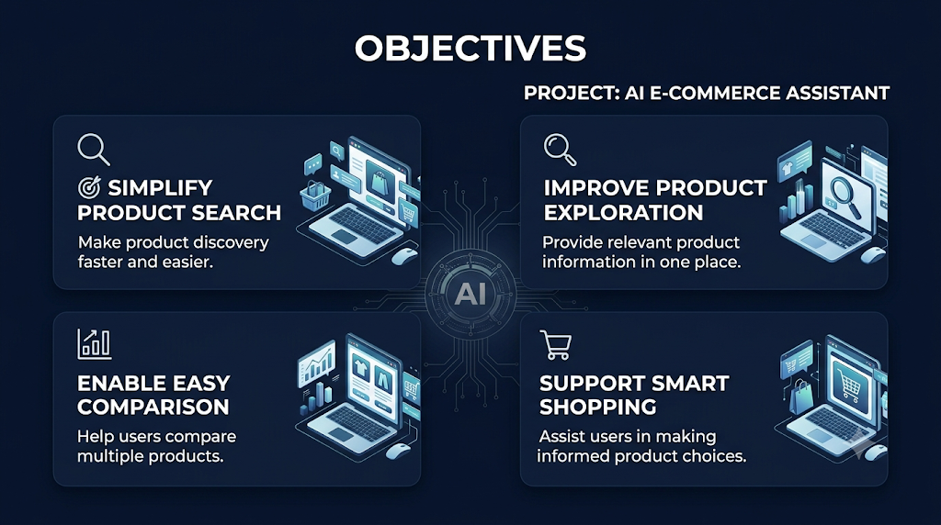
OBJECTIVES
🎯 Simplify Product Search — Make product discovery faster and easier.
🔎 Improve Product Exploration — Provide relevant product information in one place.
📊 Enable Easy Comparison — Help users compare multiple products.
🛍️ Support Smart Shopping — Assist users in making informed product choice.

Slide 6
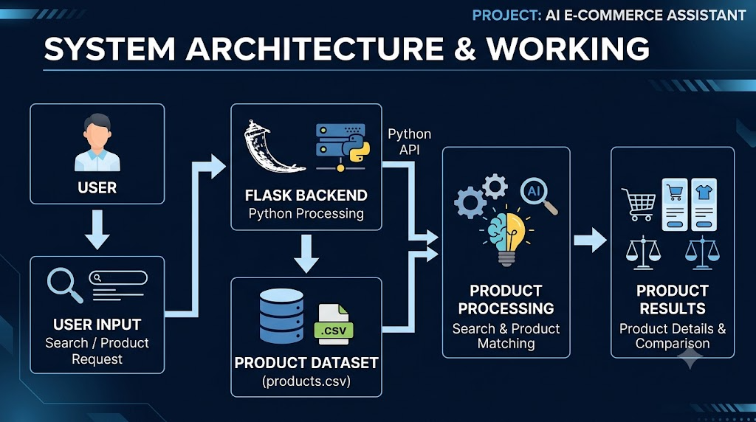
SYSTEM ARCHITECTURE & WORKING
👤 User Input — User searches for required products.
🤖 AI Assistant — Processes the request and identifies suitable products.
📦 Product Dataset — Retrieves product details from the available product data.
📊 Results & Comparison — Displays products for exploration and comparison.
Inspect
Install required Python packages (Flask and and ensure products.csv and templates/ are present.

Slide 7
TECHNOLOGY STACK & KEY FEATURES
🛠️ Technology Stack
Python + Flask — Backend development
HTML + CSS + JavaScript — Frontend interface
CSV Dataset — Product information storage
Poppins UI Design — Clean and modern interface
⭐ Key Features
🔍 Product Search — Find products easily
📊 Product Comparison — Compare different options
🌐 Multi-Platform Products — Amazon, Flipkart, Meesho, AJIO & Myntra
🤖 AI-Assisted Shopping — Supports intelligent product exploration

Slide 8
IMPACT, BENEFITS & FUTURE SCOPE
🌟 Better Shopping Experience — Makes product discovery and exploration easier.
⏱️ Saves User Time — Reduces the effort required to search and compare products.
📊 Improved Decision-Making — Helps users examine multiple product options.
🚀 Future Scope — Personalized recommendations, advanced AI assistance, and real-time product information.

Slide 9
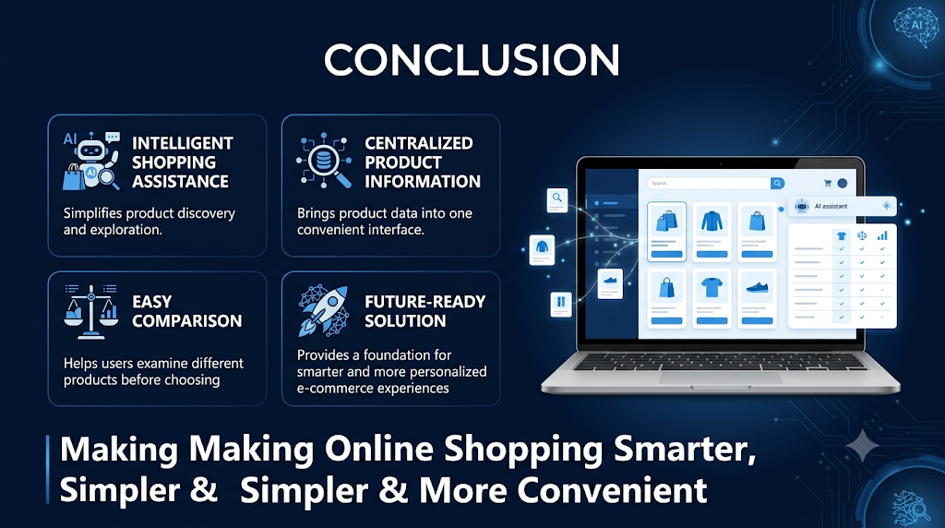
CONCLUSION
🤖 Intelligent Shopping Assistance — Simplifies product discovery and exploration.
🔍 Centralized Product Information — Brings product data into one convenient interface.
📊 Easy Comparison — Helps users examine different products before choosing.
🚀 Future-Ready Solution — Provides a foundation for smarter and more personalized e-commerce experiences.

Slide 10
Thank You!

